Slide 1
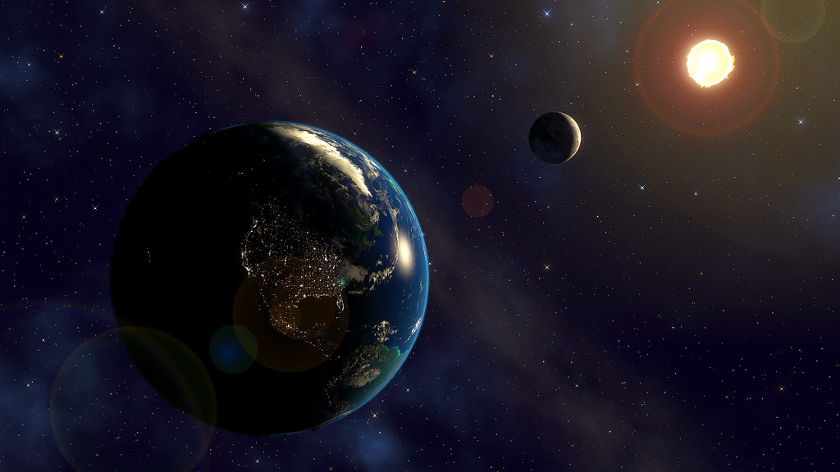
Earth-Moon-Sun system
Size
Distance
Motion

Slide 2
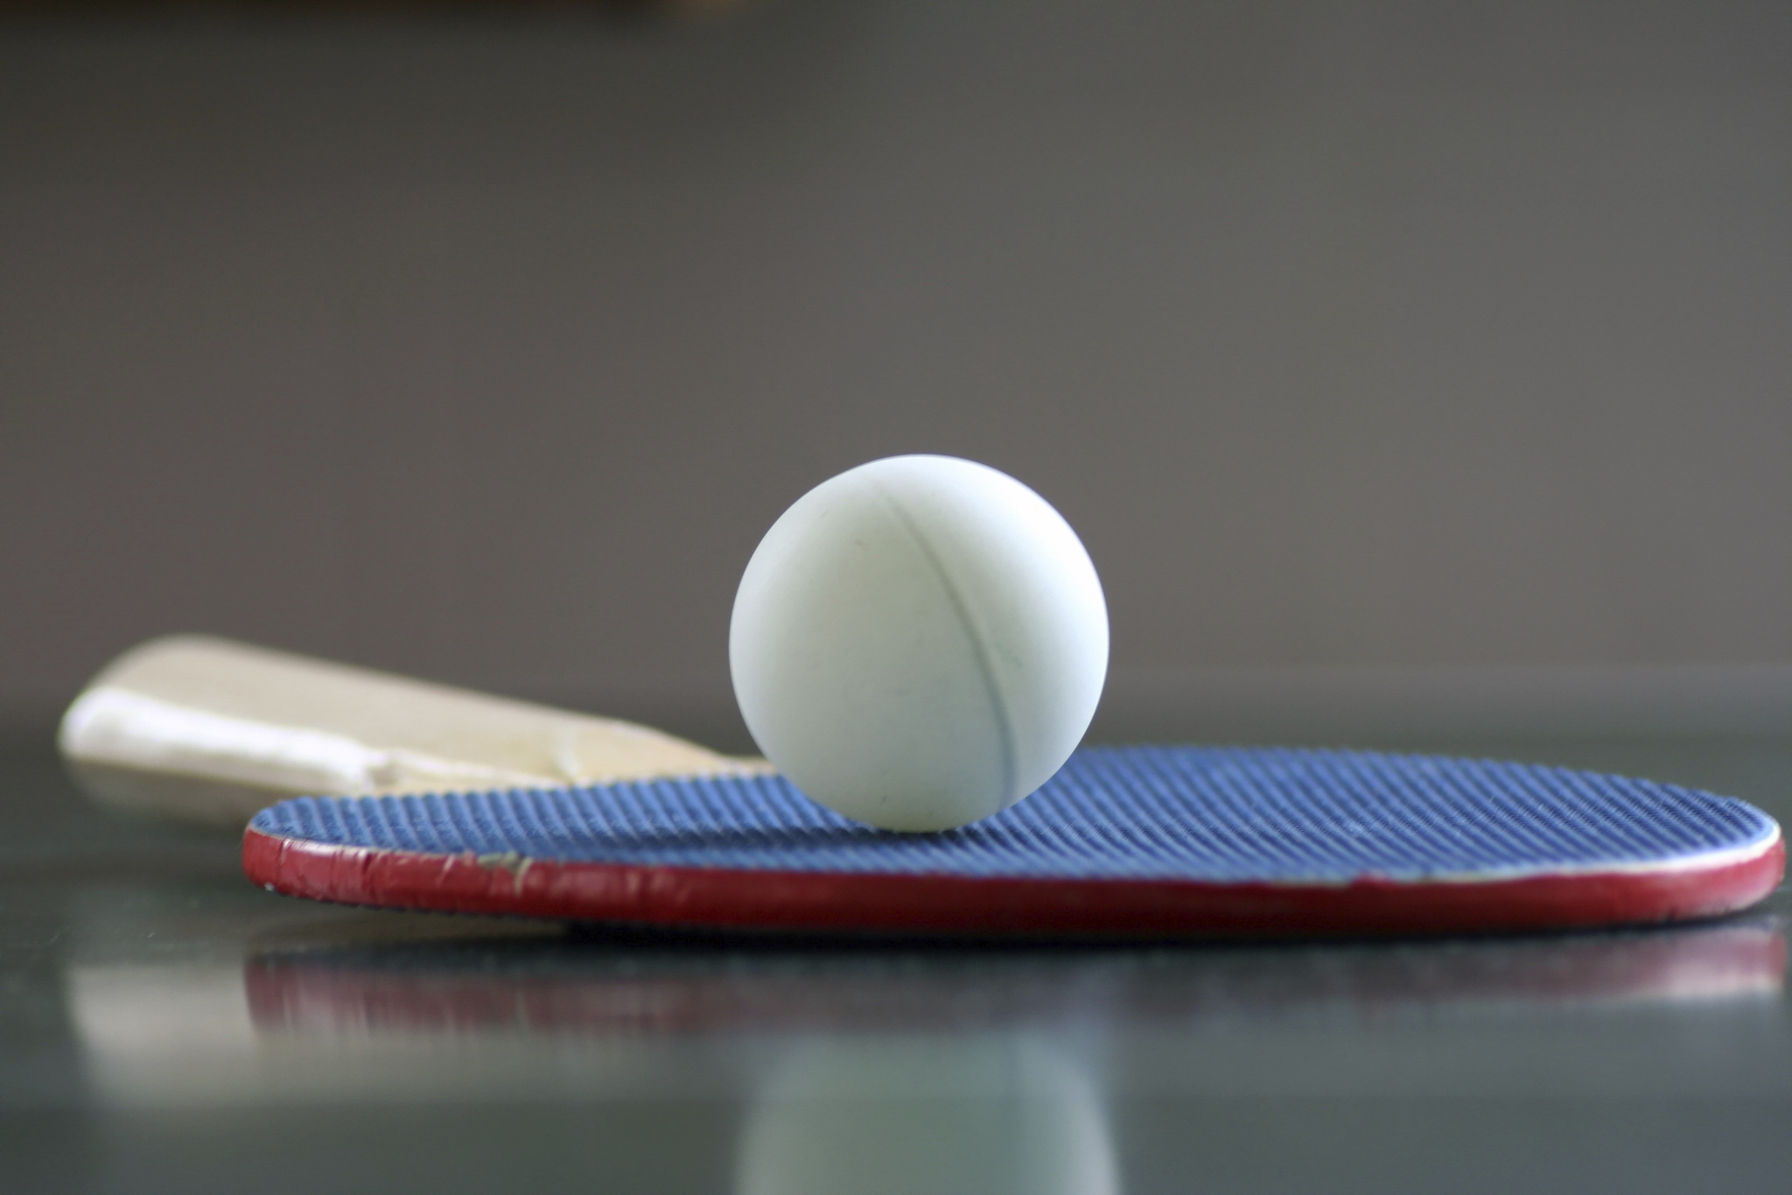
If the Moon were the size of a…
Can you guess the size of the Earth?
If the Moon were the size of a ping pong ball, the Earth would be…

Slide 3
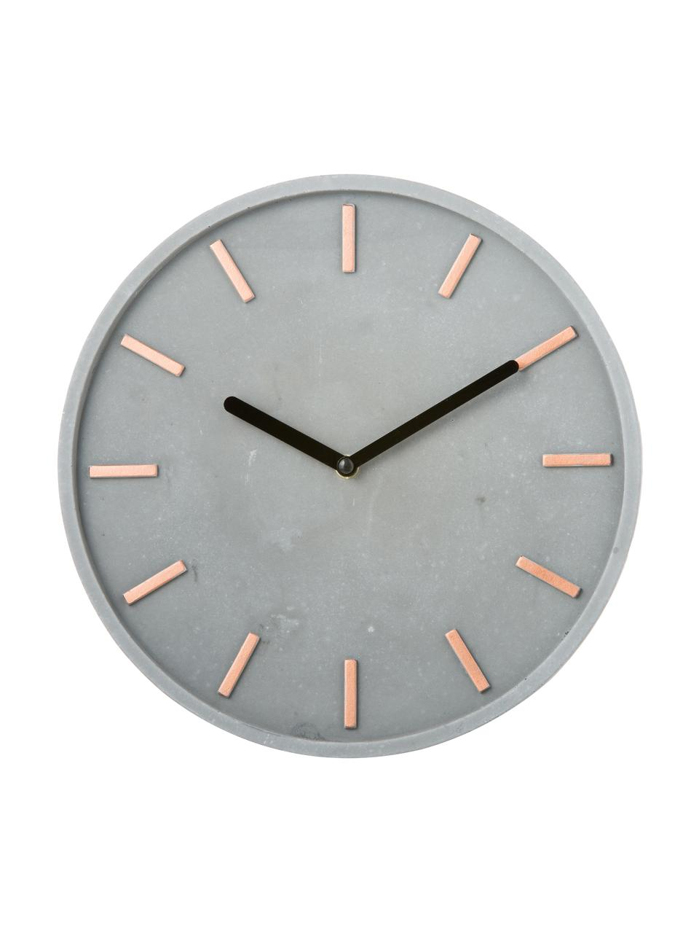
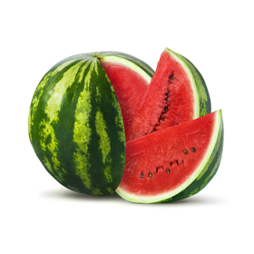
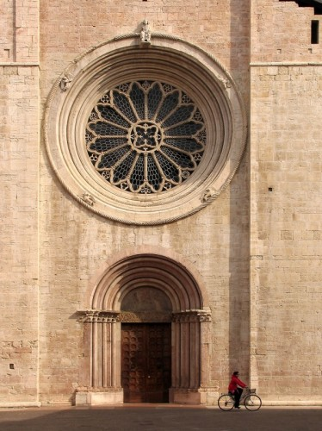
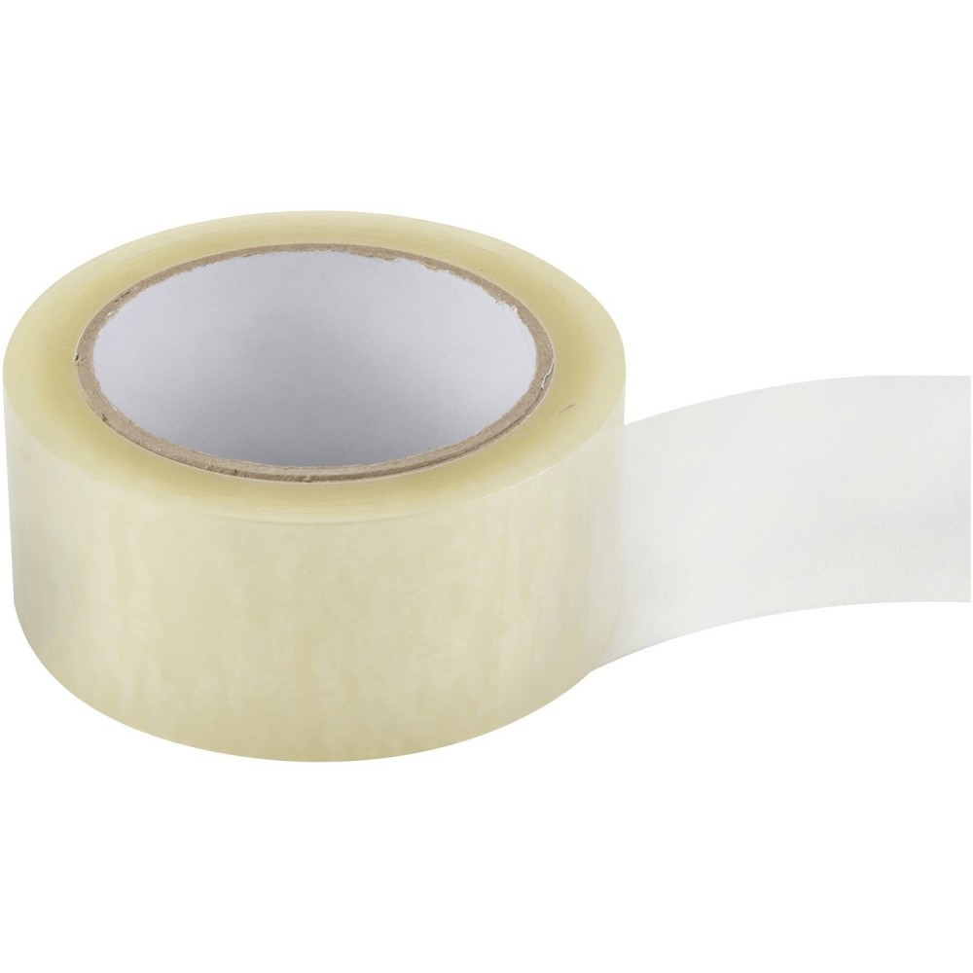
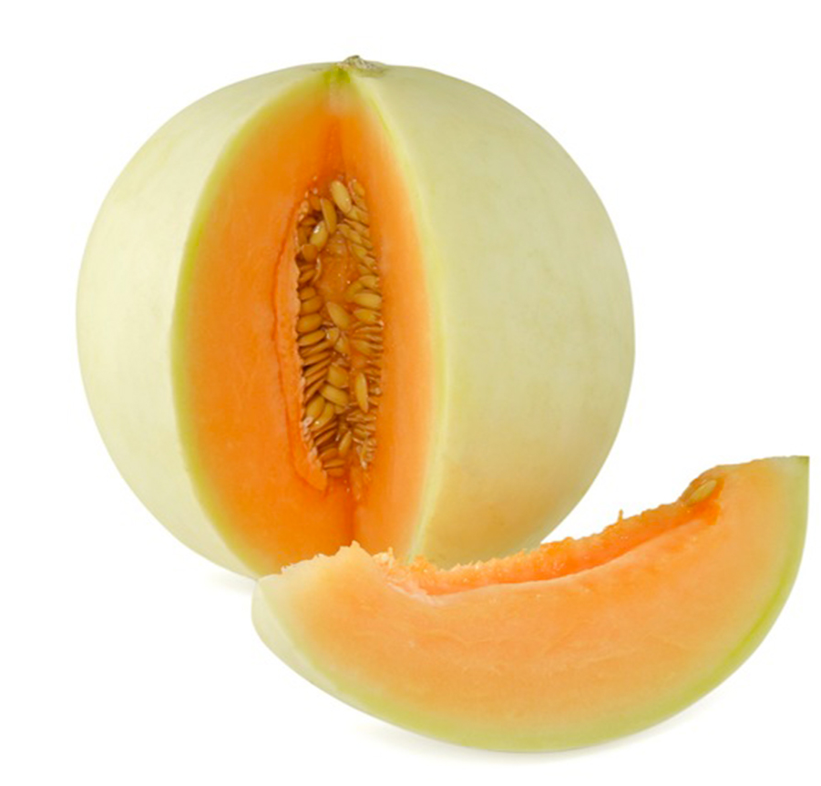
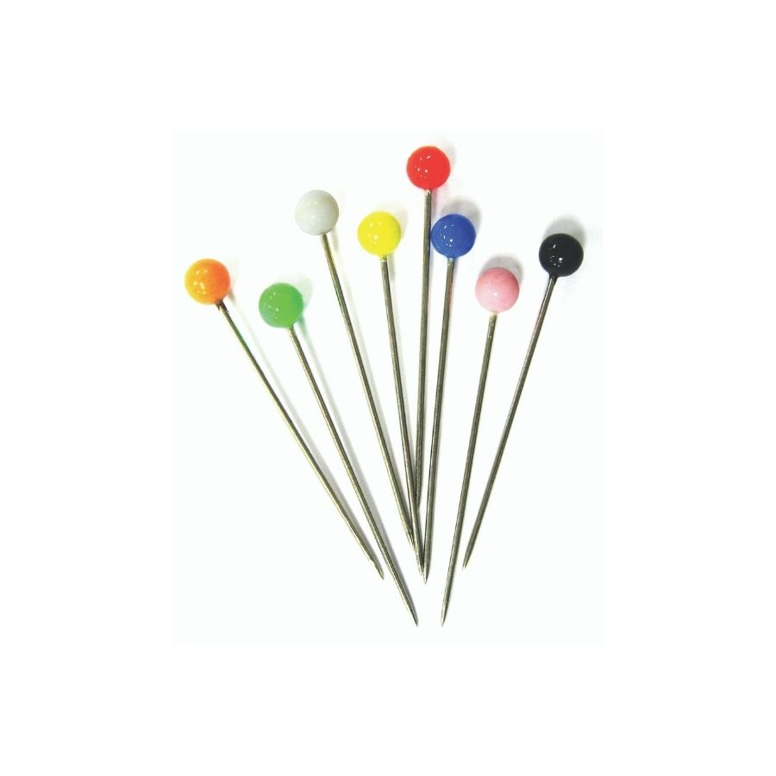
Rose window
Clock
Sticky tape
Watermelon
Melon
Pin
Bicycle wheel
Soccer ball

Slide 4
Moon real size 1.738 km
Earth real size 6.367 km
ping pong ball size 4 cm ???
(the Moon in the model) (the Earth in the model)
M diameter (model) : M real diameter = E diameter (model) : E real diameter
If the Moon were the size of 4 cm, the Earth would be 14,5 cm
…and can you guess the distance?

Slide 5
If the Moon were the size of a ping pong ball,
the Earth would be like a small melon…
…and what a surprise, the distance in between
is 4 meter and a half!
You can’t imagine the Sun would be
large as a 5 floors building,
and what’s more
it would be 1,7 km far from here,
no way!

Slide 6
PAIR WORK
Choose any circular object and make it modelling the Moon, then measure its diameter and solve the proportion to find the the size of the Earth and the Sun in your own scale model. Work out the distances in the same way. Organize your data in a table and, depending on the scale of your model, collect objects and realize it (can you take a picture of the model?).
M diameter (model 2) : M real diameter = E diameter (model 2) : E real diameter
x
 | Size (mean diameter) |  |  |  | Distance from Earth
 | Real (km) | Model 1 (cm) | Model 2 |  | Real (km) | Model 1 (m) | Model 2
Moon | 1.738 | 4 | … |  | 400.000 | 4,4 | …
Earth | 6.367 | 14,5 | … |  | 0 | 0
Sun | 1.390.000 | 1.600 | … |  | 150.000.000 | 1.700

Slide 7
INDIVIDUAL WORK (speech bubble)
Write down at least 3 sentences expressing surprise about the enormous distances among us and the Moon or the Sun. Explain how big are these celestial bodies in your model using conditionals and comparatives.
Upload your work on MIRO.
If the Moon were the size of …, the Earth would be…
If the Sun were the size of …, the Earth would be…
and what’s more, it would be … meters/km far from the Earth.
The Earth is …. times bigger than the Moon.
The distance E-S is …. times larger than the distance E-M.
What a surprise / You can’t imagine / No way!

Slide 8
LAB ACTIVITY (GROUP WORK)
4 steps before the exploration:
Spherical object’s illumination (night and day)
Earth’s rotation (approximately 24 hours)
Moon’s revolution (approximately 28 days)
The planes of the orbits are tilted

Slide 9
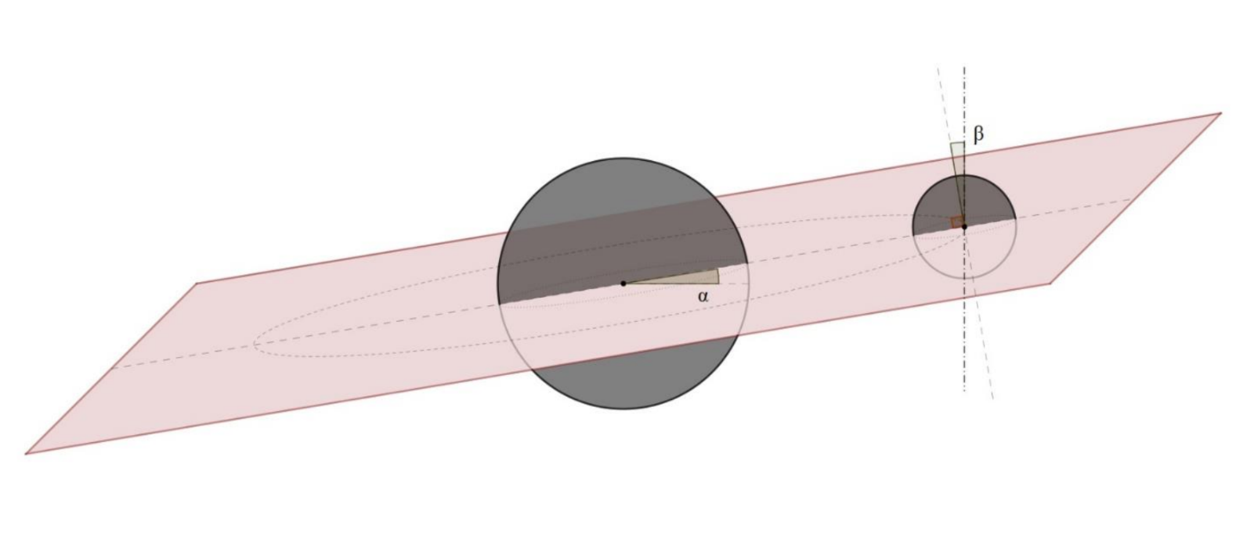
The plane of Moon’s orbit around the Earth
is tilted by about 5° with respect to
the plane of Earth’s orbit around the Sun

Slide 10
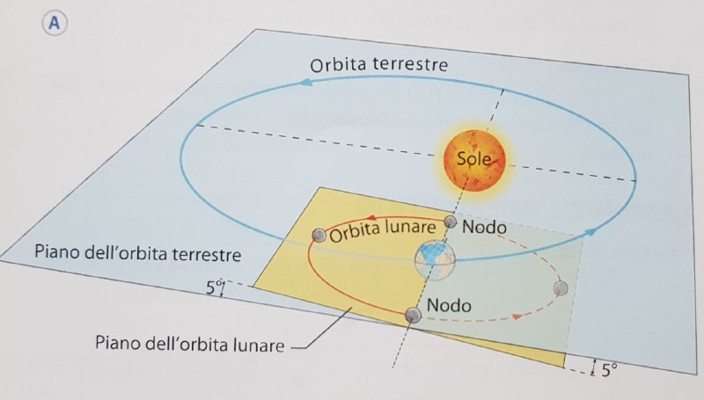
Earth’s orbit
Moon’s orbit
Plane of Earth’s orbit
Node
Plane of Moon’s orbit

Slide 11
Three phenomena to be investigated:
Phases of the Moon
The dark side of the Moon
Eclipses

Slide 12
Keep in mind…
Spherical object’s illumination (night and day)
Earth’s rotation (approximately 24 hours)
Moon’s revolution (approximately 28 days)
The planes of the orbits are tilted

Slide 13
Example

Slide 14
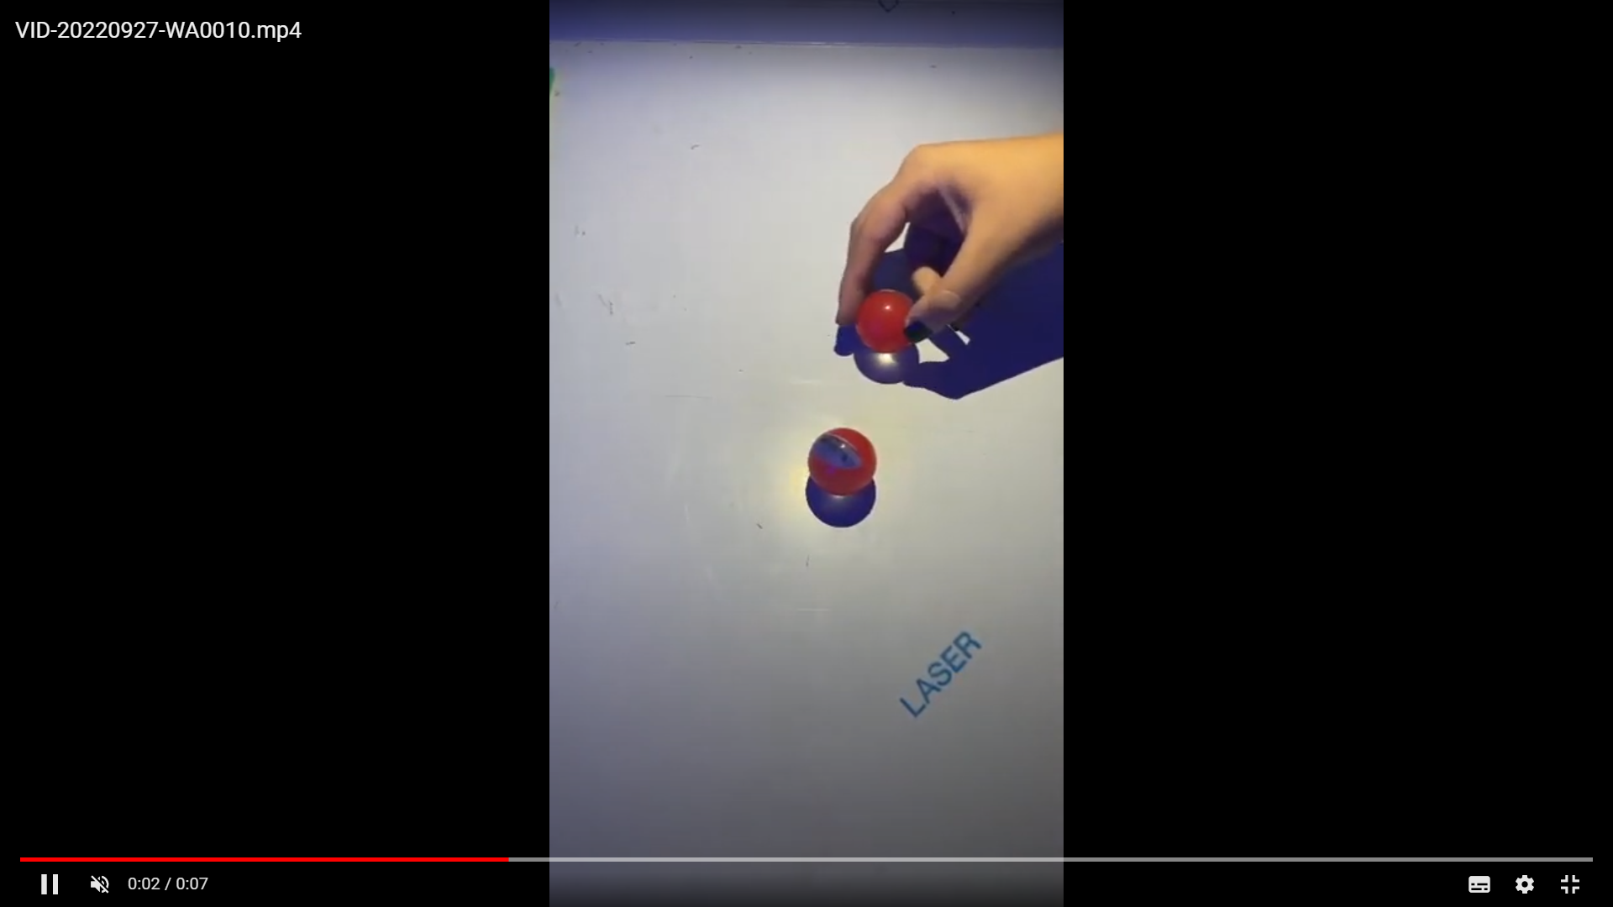
Example

Slide 15
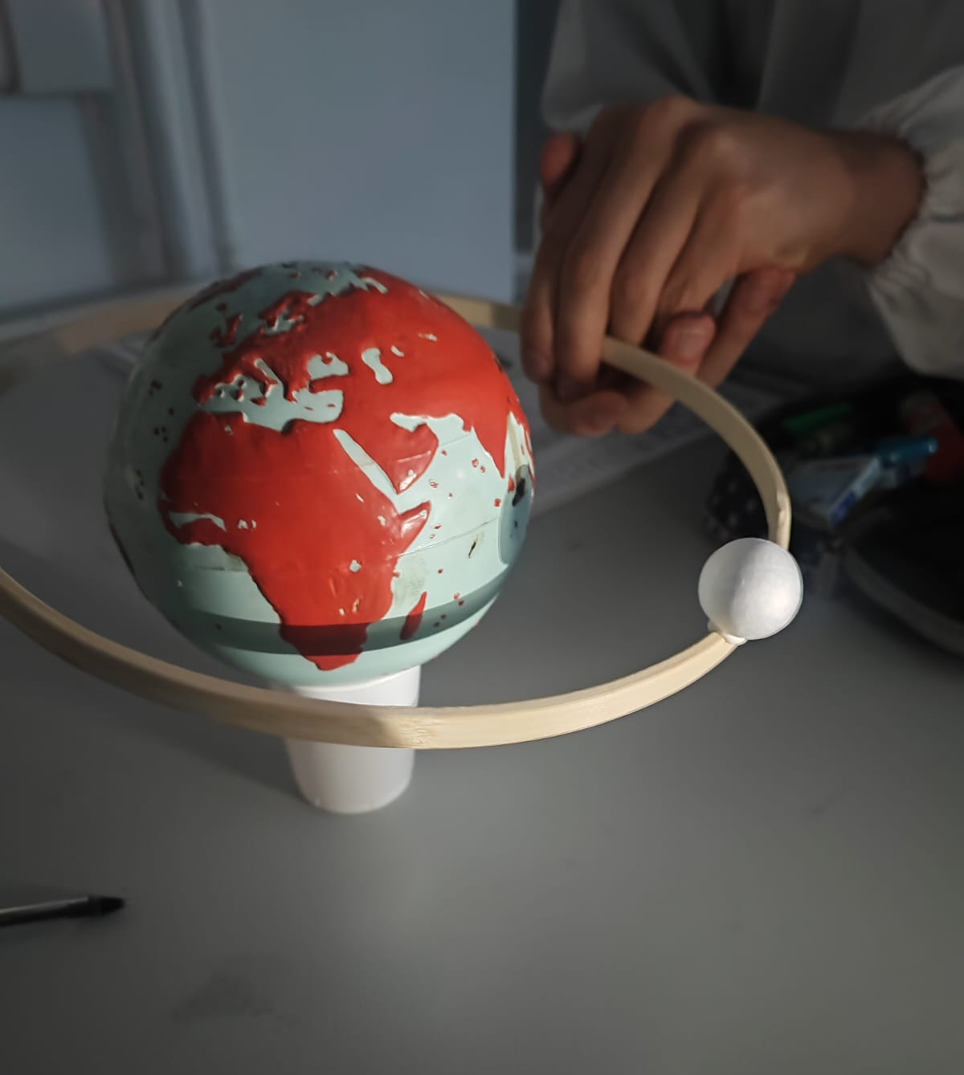
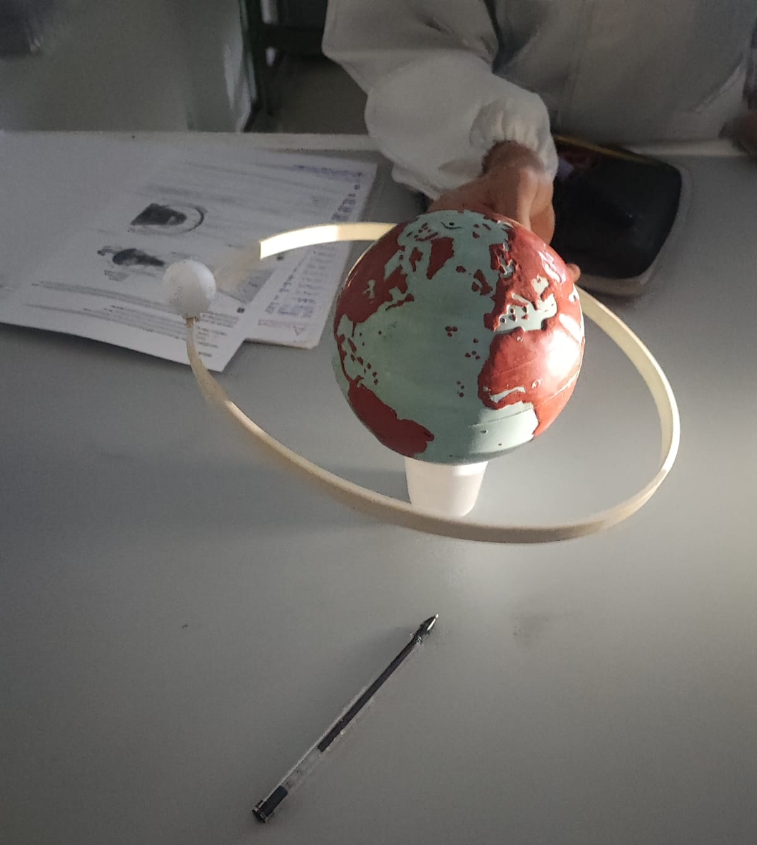
Example

